Slide 1
IoT/cloud enabled Industry Automation System
Tranzcend eco-drives pvt limited

Slide 2
Main function of the unit
Display temperature and humidity on point of measure using LCD board for easy monitoring.
Store the data in a remote cloud based storage solution for remote monitoring and future analysis.
Enable only authorized personnel to view the data using web and app based portals.

Slide 3
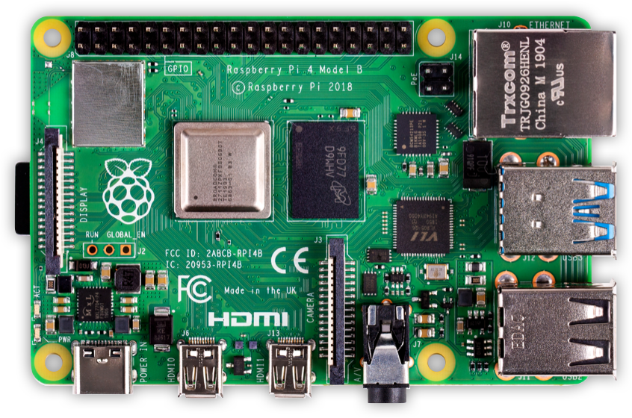
The main system is equipped with high end processor with inbuilt
Hardware
Raspberry pi - High speed processor unit LED display Connecting wires
SOFTWARE
Firebase
Android Studio
Visual Studio

Slide 4
Specification
Model | TZHT-J
 | Temperature only RHD-J101 (Pt100Ω3-wire resistance)
 | Humidity Sensor
Power | AC 230V
Temperature measurement range | 0 to +50℃ (accuracy ±0.5℃)
Humidity measurement range | 20 to 95%rh (accuracy ±3%rh at 25℃)
Features | Digital display of the data with variable size of the display panel based on customer requirement IOT based data availability to the central system via cloud Central system monitors data of 4 systems
Dimension | 120 x 70 x 41mm
Package | In SS metal case

Slide 5
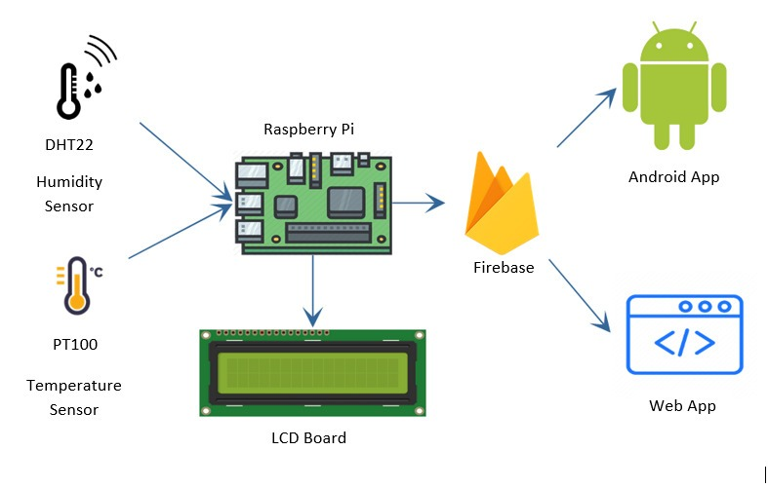
BLOCK DIAGRAM

Slide 6
Firebase
Features of Firebase used in the project.
Authentication:
Authentication of the user (client) by entering the email ID and password.
FireStore
Firestore is used for storing the username and whether the given user is an admin user or normal user.
Realtime Database
The database is used to store the sensor nodes’ data Both Temperature and Humidity data of all sensor nodes are stored on Realtime database.

Slide 7
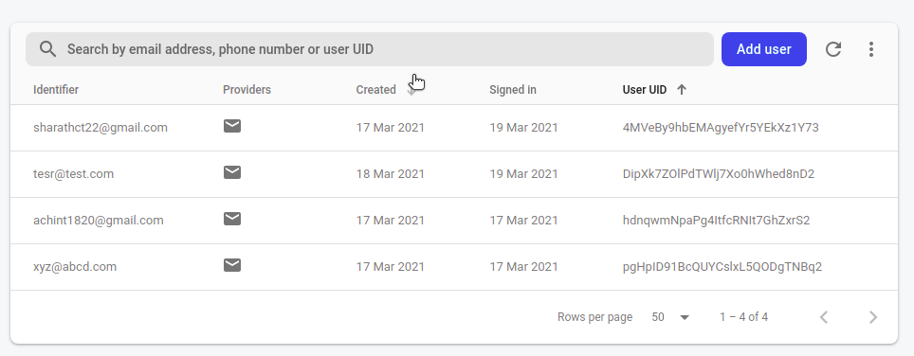
Firebase Authentication

Slide 8
Firebase Firestore

Slide 9
Firebase Realtime Database

Slide 10
Firebase (contd.)
The structure of the database is as follows.
There are two fields to be filled –
Temperature
Humidity
Since there are 10 sensor nodes strategically placed in the office workspace and production units, there are 10 sub-fields for each of these 2 fields which are continuously being updated in the real-time database.
Each of these sensor nodes record data at regular intervals in the format of {“timestamp” : “sensor value”}. Rather than the new values replacing previous values, the new values are appended to a list of older values thus paving way for future analysis on the data.

Slide 11
Android Application
The mobile application makes the data collected in the database more accessible to the clients. It displays the information gathered in a simple and lucid manner increasing the effectiveness of the main objective of this undertaken project.
The user can select which environmental factor of the two is to be displayed. They can also choose which all sensor nodes’ has to be displayed.
The data can be filtered further in multiple ways: - all the data in the database for the given sensor nodes. - data in the last ‘x’ minutes, hours, days, weeks, months or years. - the last ‘x’ data entries - data between two given dates and times.
A navigation bar is provided to navigate between temperature and humidity graphs. The graph also has a logout button for the user, a day/night mode toggle switch for the app. For admin users an additional button is visible which allows them to register new users who has access to both the mobile and web apps.

Slide 12
Android Application
Signup Page
Login Page

Slide 13
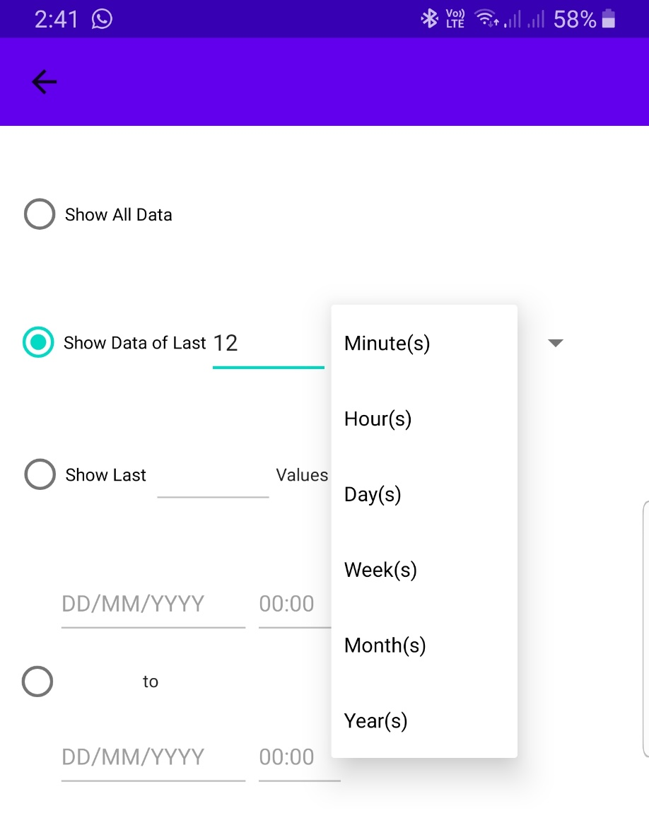
Android Application
Selecting Data Filters
Selecting Sensor Nodes

Slide 14
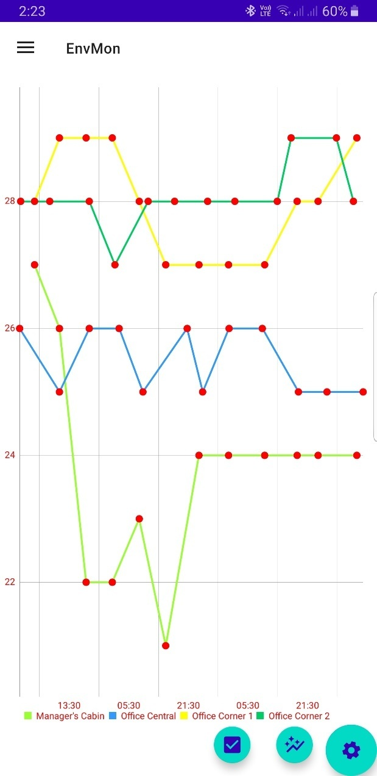
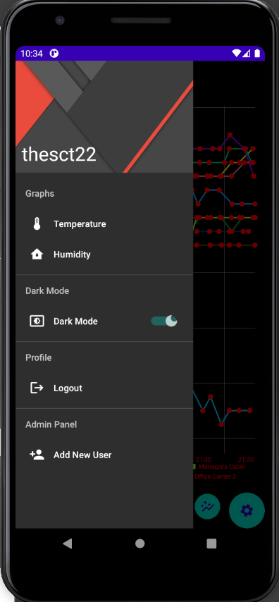
Android Application
Navigation Bar
Humidity Graph Page

Slide 15
Web Application
The website is built using ReactJS, a framework based on JavaScript.
It is hosted on GitHub Pages.
A Docker container is created and is also hosted on the Raspberry Pis on the sensor nodes.
The web app has all the features that the mobile app has which were mentioned in the previous slides.
The navigation bar on the web app has an additional Refresh button which helps to refresh the graph after filters have been applied to the graph.
The Legend button on the navigation bar helps to hide/unhide the legend of the graph.

Slide 16
Login Page of the web app

Slide 17
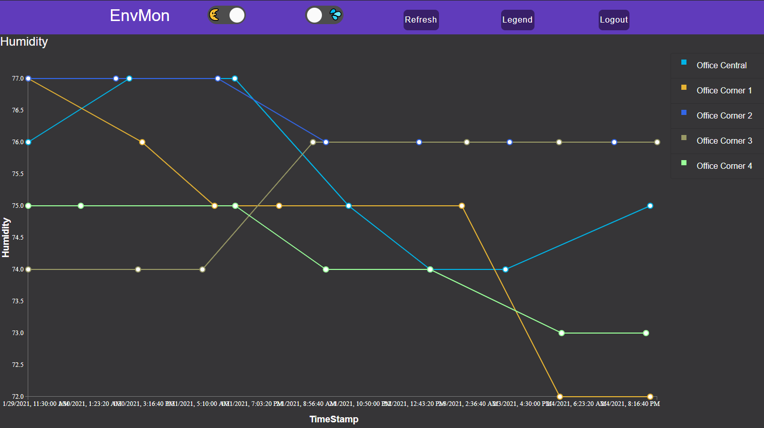
Website
Graph with values plotted.

Slide 18
Applied Filters

